Slide 1
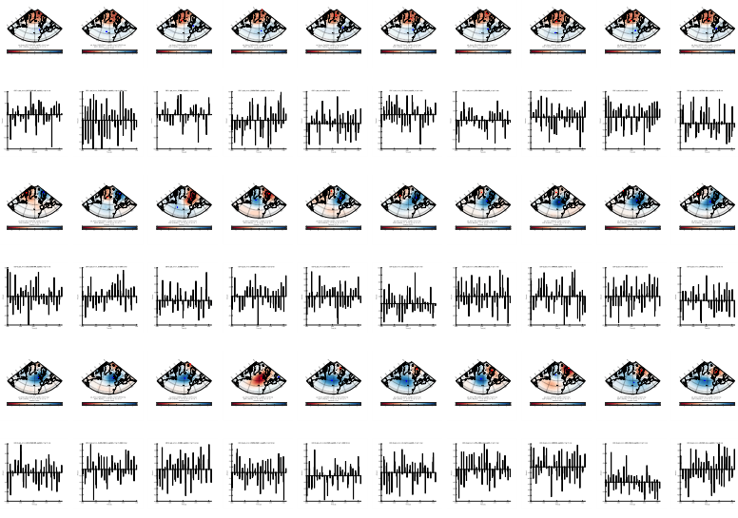
Assessment of atmospheric circulation indices over Greenland in an ensemble of CMIP6 models vi hedder: Florian & Susann
North Atlantic Oscillation (NAO)
Greenland Blocking Index (GBI)
--> effects on Surface Mass Balances of Greenland Ice Sheet

Slide 2
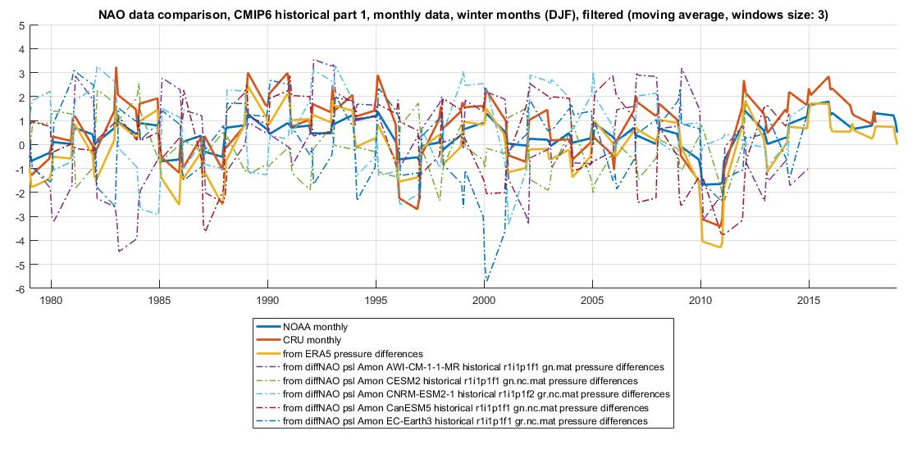

Slide 3
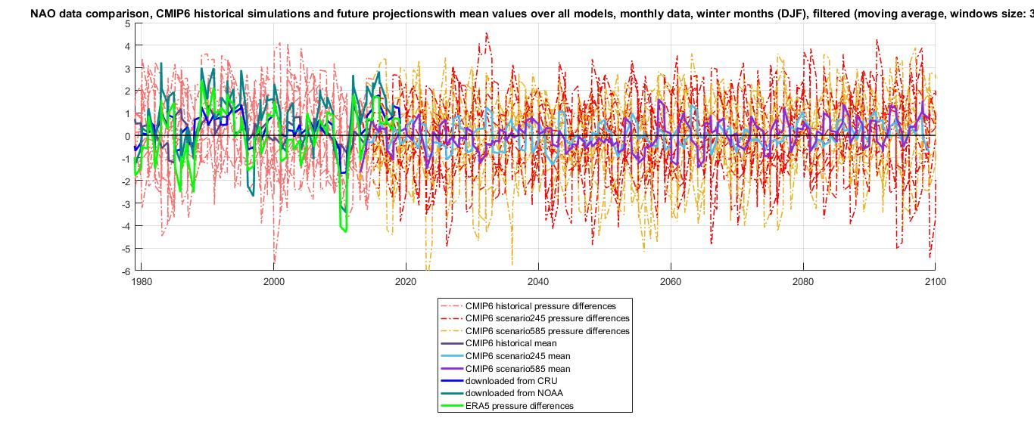

Slide 4
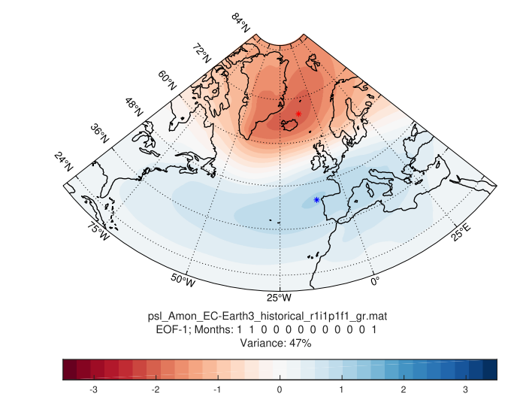
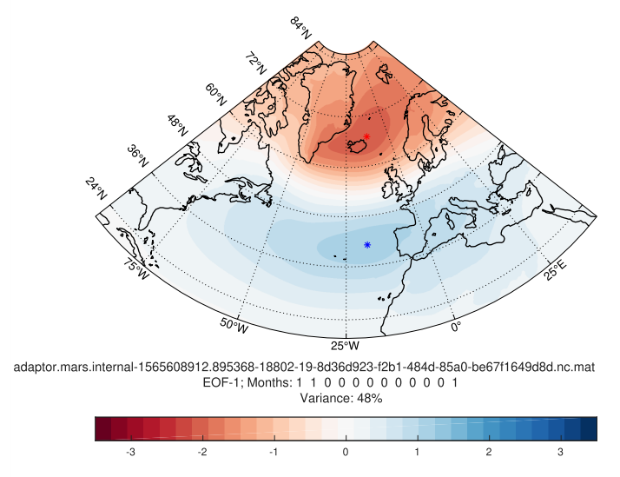
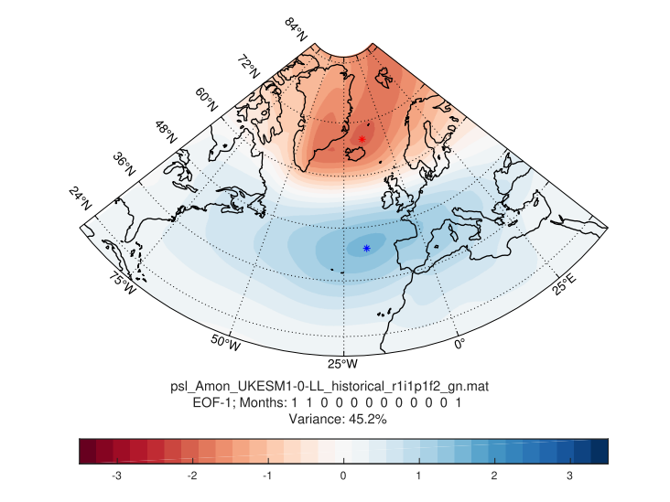
years 1979 - 2015
ERA5
EC-Earth
UKESM

Slide 5
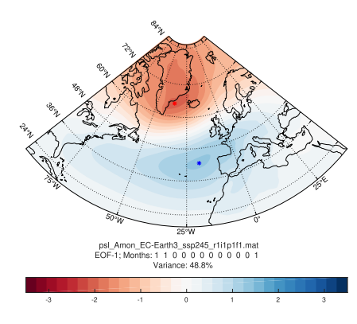
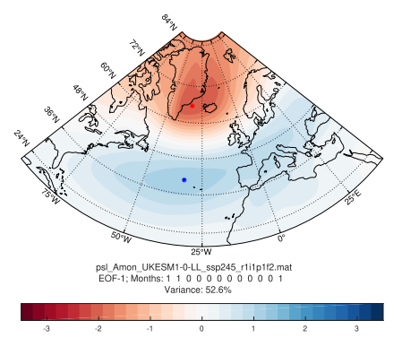
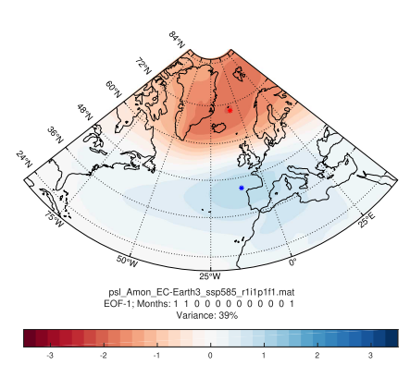
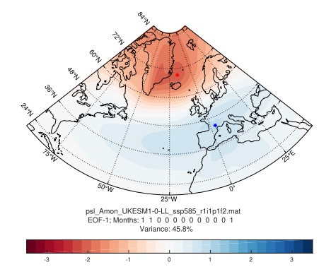
SSP 245
years 2080 - 2100
SSP 585
EC-Earth
UKESM

Slide 6
